Slide 1

STRATEGIC THINKING
how to encourage strategic thinking in your workforce
Notes:
Introduction (3 minutes)
Welcome and purpose: Equipping professional leaders with tools to translate strategic vision into tangible actions
Today's objectives:
Understand the strategic landscape of Health NZ
Develop strategic thinking capabilities
Learn practical frameworks for strategy implementation
Connect national strategies to local team actions
Create accountability and measurement systems

Slide 2

Strategic Landscape
New Zealand Health Strategy
Pae Tū: Hauora Māori Strategy
Te Mana Ola: The Pacific Health Strategy
Pae Ora (healthy futures)
Health of Disabled People Strategy
Women’s Health Strategy
Rural Health Strategy
Notes:
The Strategic Landscape of Health NZ (5 minutes)
Key Strategic Documents
Pae Ora (Healthy Futures) Act 2022
Ministry of Health
Foundation for health system transformation
Focus on equity, Te Tiriti o Waitangi principles, and community voice
Pae ora is the overarching vision for a healthy future for all New Zealanders, emphasizing healthy individuals, families, and environments. Te Pae Tata | Interim New Zealand Health Plan
Priority areas: improving equity, embedding Te Tiriti, developing the workforce, and building a financially sustainable system
Six system shifts identified for transformation
10 years

Slide 3
Strategic Landscape
Access
Timeliness
GPS
(Government Policy Statement on Health)
Infrastructure
Quality
Workforce
Notes:
The Strategic Landscape of Health NZ (5 minutes)
Key Strategic Documents
Government Policy Statement on Health
Ministry of Health
The Government Policy Statement on Health 2024-27 is the public statement of what Government expects the health system to deliver and achieve, and how success will be measured, monitored, and reported. It is also indicative of how funding will be prioritised.
The GPS sets the direction for the health system as a whole and incorporates the Government’s priorities. It sets the expectations for health entities to make sure they are working towards common goals that matter for New Zealanders.
Government Policy Statement (GPS) outlines the government's overall goals and priorities for a specific sector, while Ministerial priorities are more focused on the specific responsibilities of a Minister or Ministry within that sector. The GPS ties in with the Health Targets launched by Minister of Health Hon Dr Shane Reti in February 2024.
The development of the GPS was informed by insights gained from extensive public consultation undertaken to inform the development of the New Zealand Health Strategy and associated Pae Ora | Healthy Futures strategies last year.
The GPS also sets clear parameters for the New Zealand Health Plan, which will be published by Health New Zealand in 2024, and
2024-2027

Slide 4
Strategic Landscape
Faster cancer treatment
Shorter stays in ED
Faster access to primary MHA services
Shorter MHA-related stays in ED
Government Health Targets
Faster access to specialist MHA services
Improved immunisation for children
Strengthened focus on prevention and early intervention
Shorter wait times for FSA’s
Shorter wait times for elective services
Increased MHA workforce development
Notes:
The Strategic Landscape of Health NZ (5 minutes)
Key Strategic Documents
Government Policy Statement on Health
Ministry of Health
The Government Policy Statement on Health 2024-27 is the public statement of what Government expects the health system to deliver and achieve, and how success will be measured, monitored, and reported. It is also indicative of how funding will be prioritised.
The GPS sets the direction for the health system as a whole and incorporates the Government’s priorities. It sets the expectations for health entities to make sure they are working towards common goals that matter for New Zealanders.
Government Policy Statement (GPS) outlines the government's overall goals and priorities for a specific sector, while Ministerial priorities are more focused on the specific responsibilities of a Minister or Ministry within that sector. The GPS ties in with the Health Targets launched by Minister of Health Hon Dr Shane Reti in February 2024.
The development of the GPS was informed by insights gained from extensive public consultation undertaken to inform the development of the New Zealand Health Strategy and associated Pae Ora | Healthy Futures strategies last year.
The GPS also sets clear parameters for the New Zealand Health Plan, which will be published by Health New Zealand in 2024, and
2024-2027

Slide 5
Strategic Landscape
Pae Ora
Kahu Taurima | maternity and Early years
Mate Pukupuku | People with Cancer
Tāngata Whaikaha | Disabled People
Te Pae Tata
(interim NZ health plan)
Māuiuitanga Taumaha | People living with chronic health conditions
Oranga Hinengaro | People living with mental distress, illness and addictions
Māori Health
Pacific Health
Notes:
The Strategic Landscape of Health NZ (5 minutes)
Key Strategic Documents
Te Pae Tata | Interim New Zealand Health Plan
Te Pae Tata interim New Zealand Health Plan is the formal document that sets out the first two years of action for Health New Zealand
Te Pae Tata outlines the first steps of what we will do differently to build the foundations of a sustainable and affordable, unified health system that better serves all of Aotearoa’s people and communities.
2022-2024

Slide 6
Strategic Landscape
?
?
?
Te Pae Waenga
(NZ Health Plan)
?
?
?
Notes:
The Strategic Landscape of Health NZ (5 minutes)
Key Strategic Documents
What is next
Plan to follow on from Te Pae Tata
Due out in 2024 but still waiting…

Slide 7
Strategic Landscape
Strengthening our Te
Waipounamu Integrated
HealthCare System –
our ‘South Star
Directorate / Facility
/ Service
Health NZ Southern
Notes:
The Strategic Landscape of Health NZ (5 minutes)
Key Strategic Documents
Strengthening our Te Waiponamu Integrated HealthCare System – our ‘South Star
Martin Keogh’s plan for navigating Te Wai Pounamu to it’s future state
1. Establishing a Te Waipounamu Senior Leadership Team
2: Establishing Regional and refining District, Hospital and our broader community health care system committees to ensure appropriate Governance is in place with greater alignment, consistency, reporting and monitoring
3: Developing a Te Waipounamu Strategic Plan
4: Developing a Te Waipounamu Workforce Strategy
5: Providing excellence in timely care
6: Living within our means
Health NZ Southern
Directorate/Facility/Service

Slide 8

Expand your perspective
Challenge assumptions
Think systemically
Focus on the future
Notes:
Strategic Thinking: A Leadership Skill (5 minutes)
What is Strategic Thinking?
Looking beyond day-to-day operations to see the bigger picture
Connecting disparate pieces into a coherent whole
Anticipating future trends and adapting accordingly
Making decisions that align with long-term objectives
Developing Your Strategic Thinking
Expand your perspective
Regularly scan the environment (political, economic, social, technological factors)
Seek diverse viewpoints, especially from frontline staff and communities
Challenge assumptions
Question "we've always done it this way" thinking
Test your mental models against emerging evidence
Focus on the future
Allocate dedicated time for forward thinking
Consider multiple possible scenarios
Think systemically
Understand interconnections between services, teams, and outcomes
Recognize that changes in one area affect the entire system

Slide 9
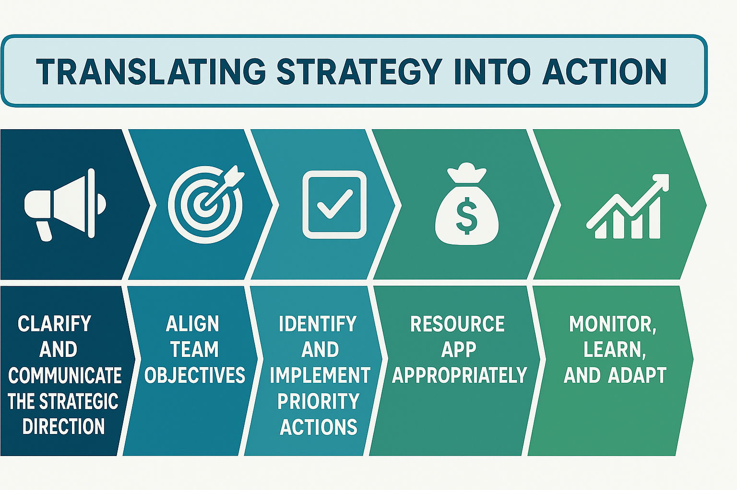
Notes:
Translating Strategy into Action: The Framework (7 minutes)
1. Clarify and Communicate the Strategic Direction
Simplify complex strategies into clear, compelling messages
Create a narrative that connects to people's everyday work
Use visual tools like strategy maps to show relationships between goals

Slide 10
Notes:
Translating Strategy into Action: The Framework (7 minutes)
2. Align Team Objectives
Cascade strategic goals to team-level objectives
Co-create team plans that contribute to broader strategies
Use the OKR (Objectives and Key Results) framework:
Objectives: What we want to achieve
Key Results: How we'll measure succes

Slide 11
Notes:
Translating Strategy into Action: The Framework (7 minutes)
3. Identify and Implement Priority Actions
Focus on high-leverage activities that drive multiple strategic goals
Start with quick wins to build momentum
Create detailed implementation roadmaps with clear ownership

Slide 12
Notes:
Translating Strategy into Action: The Framework (7 minutes)
4. Resource Appropriately
Align budgets with strategic priorities
Invest in capability development needed for strategy execution
Reallocate resources from lower to higher priority activities

Slide 13
Notes:
Translating Strategy into Action: The Framework (7 minutes)
5. Monitor, Learn, and Adapt
Establish regular review cycles
Create feedback loops with frontline staff and patients
Be willing to course-correct when evidence suggests change is needed

Slide 14

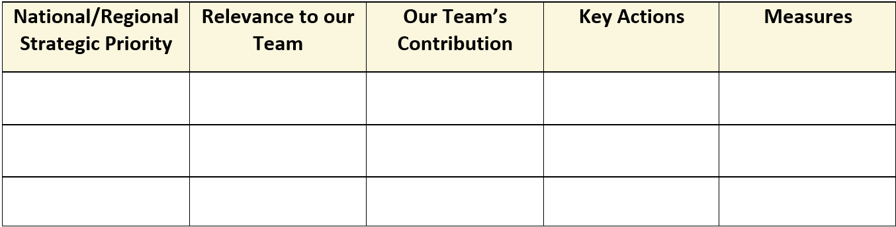
Notes:
Practical Application: Connecting National Strategies to Local Action (7 minutes)
Case Study: Implementing Pae Ora Principles in Your Team
Strategy Review
Identify which elements of Pae Ora most directly impact your service area
Determine where your team can make the greatest contribution
Team Engagement
Facilitate discussions about what these strategies mean for daily work
Invite team members to identify implementation opportunities
Action Planning Template
Strategic Goal: [From national/regional strategy]
Team Objective: [How your team contributes]
Specific Actions: [Tangible steps]
Resources Needed: [People, funding, tools]
Timeline: [Key milestones]
Measures of Success: [How you'll know you're making progress]

Slide 15
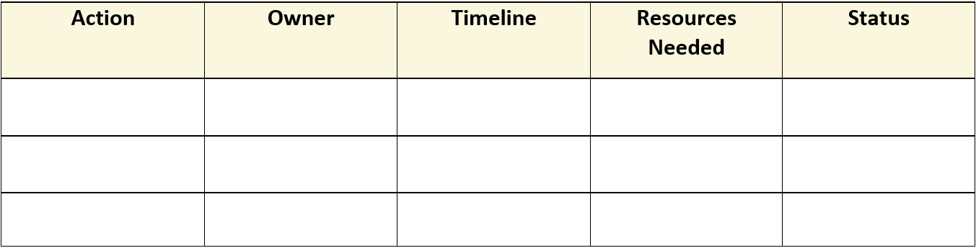
Notes:
Practical Application: Connecting National Strategies to Local Action (7 minutes)
Case Study: Implementing Pae Ora Principles in Your Team
Strategy Review
Identify which elements of Pae Ora most directly impact your service area
Determine where your team can make the greatest contribution
Team Engagement
Facilitate discussions about what these strategies mean for daily work
Invite team members to identify implementation opportunities
Action Planning Template
Strategic Goal: [From national/regional strategy]
Team Objective: [How your team contributes]
Specific Actions: [Tangible steps]
Resources Needed: [People, funding, tools]
Timeline: [Key milestones]
Measures of Success: [How you'll know you're making progress]

Slide 16
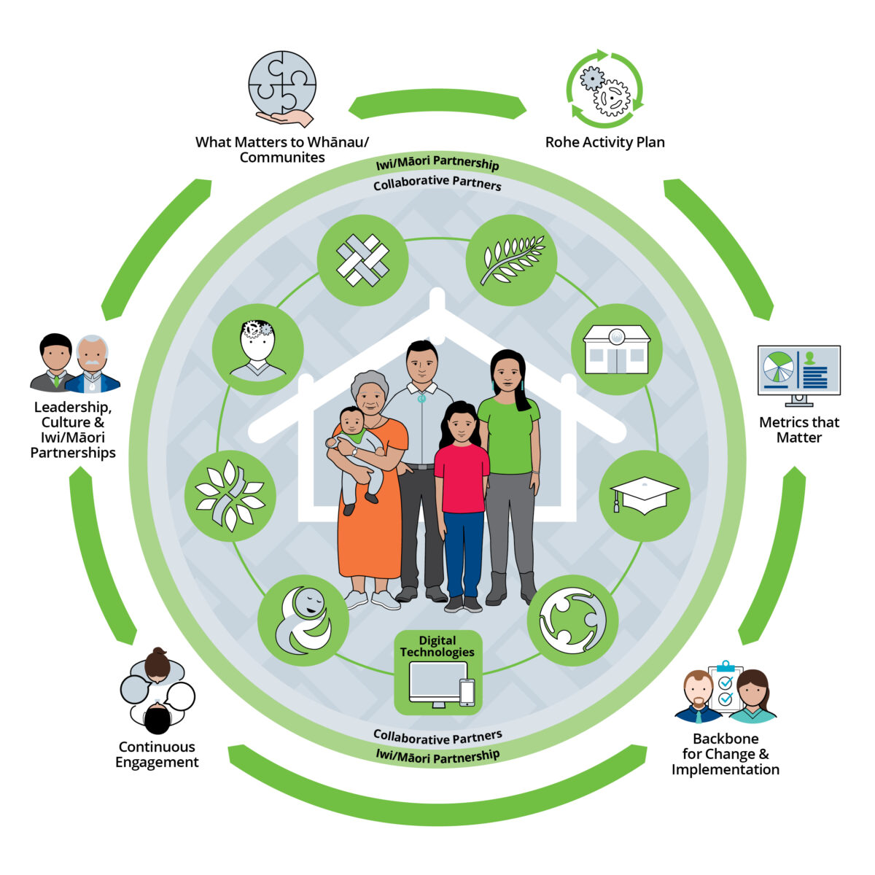
Strategic Goal
Ensure services are designed and delivered in partnership with Māori
Team Objective
Establish meaningful engagement processes with local iwi
Actions
  Schedule regular hui with iwi representatives
  Co-design service improvements
  Incorporate feedback into team workflows
Measures
Participation rates, satisfaction scores, service changes implemented
Notes:
Example: Embedding Te Tiriti Principles
Strategic Goal: Ensure services are designed and delivered in partnership with Māori
Team Objective: Establish meaningful engagement processes with local iwi
Actions:
Schedule regular hui with iwi representatives
Co-design service improvements
Incorporate feedback into team workflows
Measures: Participation rates, satisfaction scores, service changes implemented

Slide 17
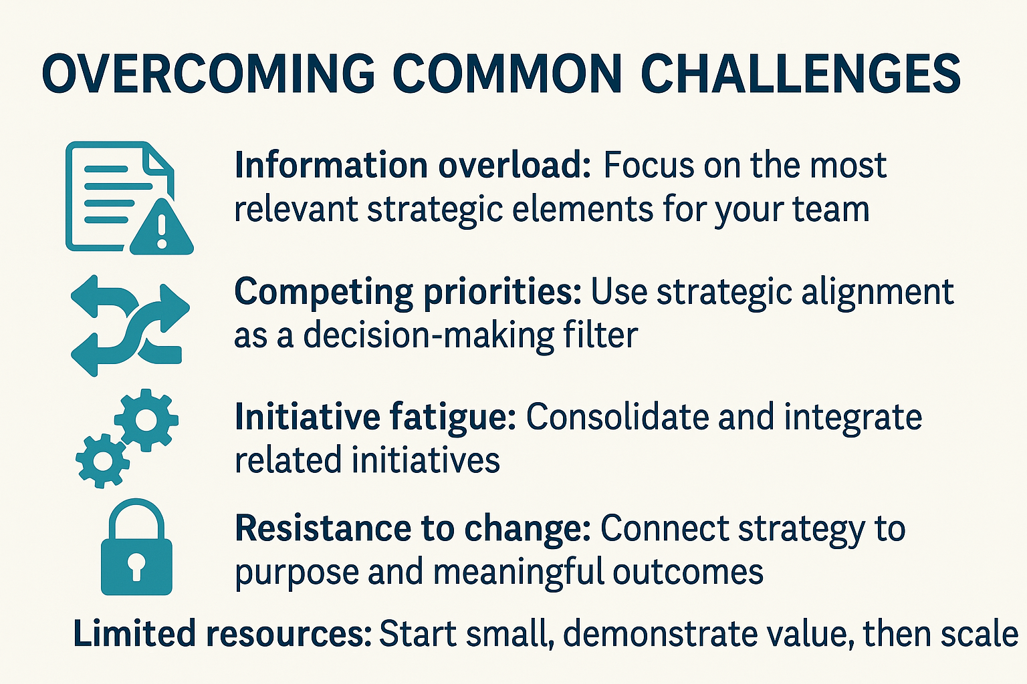
Notes:
Overcoming Common Challenges (2 minutes)
Information overload: Focus on the most relevant strategic elements for your team
Competing priorities: Use strategic alignment as a decision-making filter
Initiative fatigue: Consolidate and integrate related initiatives
Resistance to change: Connect strategy to purpose and meaningful outcomes
Limited resources: Start small, demonstrate value, then scale

Slide 18

Notes:
Next Steps and Support (1 minute)
Leadership development resources available through Health NZ
Strategy implementation toolkit to be shared following this session
Peer learning network for ongoing support and idea sharing
Follow-up workshops scheduled for [dates]

